Slide 1
Hi, I’m Kiran Vodrahalli.
Highest-Order Bits:
Final year Ph.D. Candidate @Columbia
Advisors: Alex Andoni and Daniel Hsu
Research: Theory & Practice of ML
Website: https://kiranvodrahalli.github.io
Job Search: Industry Research or Postdocs
Notes:
“And now, a bit about my research:”

Slide 2
Main Research Topics:
Resource-Efficient Learning:
Sample & Time Complexity
Sparse Models
Low-Rank Models
Streaming Settings
Controllable & Interpretable Agents:
Platform Design
Online & Reinforcement Learning
Algorithmic Game Theory
Notes:
“for future work, interested in many related settings including resource-efficient sequence modeling and continuing working on platform design + related ideas”.
“In the interest of time, I will highlight two recent projects.”

Slide 3
I also worked on applications:
Neuroscience
NLP
Robotics
Economics
Systems

Slide 4
Resource-Efficient Machine Learning
Modern ML challenge: Very large models!
Notes:
Large models: computational + statistical issues
Large amounts of data: computational issues

Slide 5
Sample & Time Complexity of Nonlinear Models
Low-rank models?
$$r$$
$$σ( x)$$
$$×$$
$$r$$
$$d$$
$$d$$
Notes:
sigma is a nonlinearity, and this block replaces full rank parameter matrix with low-rank parameters.

Slide 6
Algorithms for Efficiently Learning Low-Rank Neural Networks
Kiran Vodrahalli, Rakesh Shivanna, Mahesh Sathiamoorthy, Sagar Jain, Ed Chi
Google Brain Research Internship
(in submission + arXiv soon!)

Slide 7
Low Rank Deep Models
Replace full-rank layers with low-rank parameters.
Given weights of layer $i$:
$$W_{i}=U_{i}V_{i}^{T}$$
Standard initialization: SVD of full-rank init.

Slide 8
Nonlinear Kernel Projection (NKP)
For each layer $W∈R^{m ×n} \sim D$ with nonlinearity $σ$:
$$\min_{U∈R^{m ×r}, V∈R^{n ×r}}{E_{x∼N(0, I)}\left[||σ(Wx) −σ(UV^{T}x)||_{2}^{2}\right]}$$
Empirical gains over SVD init!
Notes:
Instead of minimizing low-rank Frobenius norm as in SVD, we minimize some kernel distance which takes the nonlinearity into account.

Slide 9
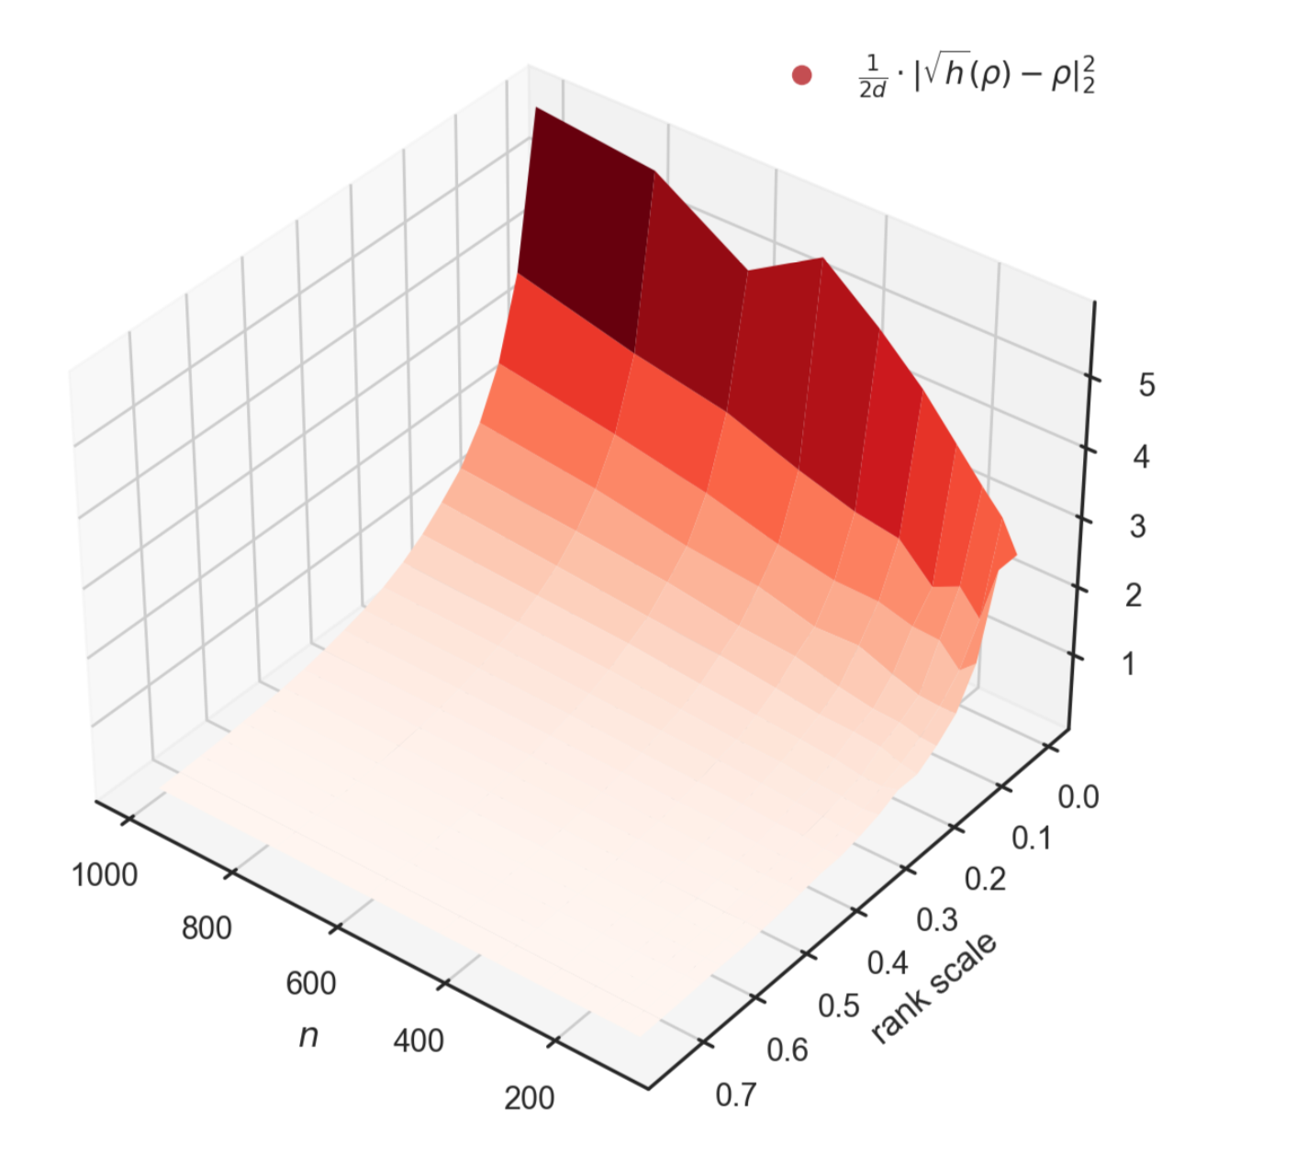
Main Results
Efficient optimal alg for NKP.
Efficient learning alg for NKP.
NKP outperforms SVD init.
Especially with:
Larger width networks
Lower rank approx.
Notes:
Contribution 1: Efficient algorithm to solve this problem when W is known.
Contribution 2: Efficient learning alg to learn low-rank solution when you only have sample access to W via sigma(Wx).
Contribution 3: Characterizing improvement over SVD init (theory + empirical tests on real deep nets).
“Both in practice and in theory.”

Slide 10
Main Results
Efficient optimal alg for NKP.
Efficient learning alg for NKP.
NKP outperforms SVD init.
Especially with:
Larger width networks
Lower rank approx.
Notes:
Contribution 1: Efficient algorithm to solve this problem when W is known.
Contribution 2: Efficient learning alg to learn low-rank solution when you only have sample access to W via sigma(Wx).
Contribution 3: Characterizing improvement over SVD init (theory + empirical tests on real deep nets).
“Both in practice and in theory.”

Slide 11
Main Results
Efficient optimal alg for NKP.
Efficient learning alg for NKP.
NKP outperforms SVD init.
Especially with:
Larger width networks
Lower rank
Notes:
Contribution 1: Efficient algorithm to solve this problem when W is known.
Contribution 2: Efficient learning alg to learn low-rank solution when you only have sample access to W via sigma(Wx).
Contribution 3: Characterizing improvement over SVD init (theory + empirical tests on real deep nets).
“Both in practice and in theory.”

Slide 12
The Platform Design Problem
Christos Papadimitriou, Kiran Vodrahalli, Mihalis Yannakakis
WINE ‘21, NeurIPS Strategic ML Workshop ‘21

Slide 13
Economics of the Online Firm
User data
Services
Online firm
Users
User data feeds revenue
Better demand segmentation
Ad/recommendation revenue
Better models => better services
Online services bring value
Convenience
Knowledge
Notes:
Our goal is to understand computational properties of the economics of the online firm. In particular, how does an online firm build platforms to attract user data? Let's move on to a simple model.

Slide 14
Picture of the General Case
What platforms should I build?
Shopping online
Driving
Exercising
Eating lunch
Studying
Online firm
Watching movie
Reading news
Agent’s Life
Notes:
We'll assume users live their lives in a Markov chain called Life.

Slide 15
Picture of the General Case
What platforms should I build?
Shopping online
Driving
Exercising
Eating lunch
Studying
Online firm
Watching movie
Reading news
At a cost, the firm can add an opt-in action to platforms they create (ex: Google Maps).
Agent’s Life

Slide 16
Picture of the General Case
Maybe we should create Maps technology….
Shopping online
Driving
Exercising
Eating lunch
Studying
Online firm
Watching movie
Builds platform Maps at a cost.
Reading news
Agent’s Life changes
opts in to Maps
Notes:
Agent gives their location data in exchange for access to maps.
Now, if Agent opts in to maps, the Agent can more easily find the retail store she wanted to purchase goods from, and can easily transition to driving to the store to purchase in person.
This is an example of complementary goods: Online advertisements reveal goods an Agent may want to buy, and building a Google Maps platform makes it easier for the Agent to go to the store and buy the good (perhaps an archaic example since now people buy things online).
We can also see how adopting Maps might change other parts of the Agent’s Markov chain (now an MDP):
Easier to find a restaurant you want to go to
Easier to find a movie theatre
Easier to find a hiking trail
Increases likelihoods of transitions from driving to a whole host of other possibilities, while also boosting likelihood from online shopping to driving to a store.

Slide 17
A Stackelberg Game
Designer moves first:
Adds platforms which modify transitions to an existing Markov Chain
Agent moves second:
Receives MDP from Designer, plays optimal behavior
Bi-level MDP optimization
Notes:
Say “Markov Decision Process”
We study computational complexity in this first work: NP-hard in general (platforms are complementary goods) , but tractable to approximate in a special case (platforms are substitute goods).

Slide 18
Grand Vision
Design environments which generate useful, sampleable data
Model economics of companies dependent on information economy
Model strategic behavior of online firms and their users
Reinforcement learning aided by environment design
Manipulation and resistance of learning agents
Notes:
Many connections to adjacent areas… very interesting and ripe for future work!

